Slide 1
AT ACADEMY: Recent Legislation Affecting Co-ops and Condominiums
May 15, 2024
Andrew P. Brucker
Peter Massa
Julie Schechter

Slide 2
Continuing Legal Education Credits
For AT to process your continuing legal education credit, you will be asked to confirm your participation in this webinar by submitting a code word in the Zoom Chat function, which will be provided at the conclusion of the session.

Slide 3
NYC Fair Chance for Housing Act
Reason for Legislation
Parallel provisions to Employment Law
Enacted as part of the of the Administrative Code relating to discrimination
The significance of this is that if there is a lawsuit, insurance will not cover the directors!

Slide 4
NYC Fair Chance for Housing Act (cont.)
What the law says: it is an unlawful discriminatory practice for the owner, lessor, lessee, sublessee, assignee or managing agent of (or other person having the right to sell, rent or lease, approve the sale, rent or lease) a housing accommodation (or any interest therein) or any agent or employee of broker to:
Refuse to sell, rent, approve the sale or rent a housing accommodation (or provide them with services in connection with housing) because of such individual’s criminal history other than the individual’s “reviewable criminal history” (see later definition)
Conduct a criminal background check except as permitted by this law.

Slide 5
NYC Fair Chance for Housing Act (cont.)
“Reviewable Criminal History” means
A conviction registered on the NY (or other state) sex offense registry.
A misdemeanor conviction (in NY or other state) where less than 3 years have passed since prison sentence.
A felony conviction (in NY or other state) where less than 5 years have passed since prison sentence.
INTERESTING: Reproductive or gender-affirming care conviction in another state (and it would not be unlawful in NY) is not included in the definition.
A covered entity may conduct and consider a criminal record but only after (in a co-op) the co-ops “commits” to the applicant (i.e., consent to the transfer).
Co-op must provide the individual with a notice and copy of the Fair Chance for Housing Act.
Once done, a copy of the background check must be provided to the individual. The individual is entitled to submit information in regard to errors in the information and supplemental or mitigating information.

Slide 6
NYC Fair Chance for Housing Act (cont.)
A copy of any information about the criminal history, other than the reviewable criminal history, that was obtained even if it was not considered in making the determination, must be sent to individual.
If the entity CONSIDERS taking adverse action due to the criminal history, it must first:
conduct an individualized assessment of the reviewable criminal history and info submitted by the individual; and
provide the individual IN WRITING the reason for the action.
The reason must include how the reviewable criminal history is relevant to the “legitimate business interest of the property owner.”
Note: The law states that this does not mean the entity cannot consider physical violence, or other acts that would adversely affect the health, safety of welfare of other residents.
Law Summary: Co-op boards may not consider a criminal record until after determining an applicant’s other qualifications. Boards may consider registered sex offenses, and misdemeanors (for 3 years) and felonies (for 5 years). If the applicant is rejected due to criminal history, the Board must provide why the rejection was due to a legitimate business interest.
This law is effective Jan, 1, 2025.

Slide 7
Corporate Transparency Act
Reason for the passage of the CTA by Congress
Foreign money in the U.S.
Criminal money in the U.S.
Terrorist money in the U.S.
The U.S. government now requires the previously undisclosed information be made available to the Financial Crimes Enforcement Network (FinCEN) of the U.S. Department of Treasury.
According to law, the information is NOT public.

Slide 8
Corporate Transparency Act (cont.)
It applies to a corporation, LLC or similar entity that is created by filing of a document with the secretary of state or similar office under the law of the state.
What about condos? They are created by a Declaration recorded with the County Clerk.
But RPL Sec. 339-s says “Each such declaration and any amendment thereof, shall be filed with the Department of State.”
But co-ops are clearly included.
Note: “Large operating companies” are exempt.
Directly employs more than 20 full-time employees.
Has more than $5 million in gross receipts or sales.
Has an operating presence at an office in the U.S.

Slide 9
Corporate Transparency Act (cont.)
What information must be reported:
info concerning the entity itself; and
info concerning “beneficial owners.”
Definition of “Beneficial Owner:”
An individual who either directly or indirectly exercises “substantial control” over a company.
An individual exercises “substantial control” if they meet any of the following:
Someone who either is a senior officer or is an important decision maker.
A senior officer is an individual holding the position of exercising the authority of a President, COO, CEO, CFO or any other officer (regardless of official title) who performs a similar function as these officers.
Someone who is an important decision maker.
Someone who has any other form of substantial control over the company.

Slide 10
Corporate Transparency Act (cont.)
What must the company disclose:
Name, address, jurisdiction of formation, EID
What must the Beneficial Owner disclose:
Name
Date of birth
Address
Unique identifying number from an acceptable ID
Passport, Driver’s License or FinCEN ID number
A copy of the document with the ID number
NOTE: Reporting companies are required to update their filings whenever a Beneficial Owner changes (or their info changes).
So there must be filing every time there’s a new board member!

Slide 11
Corporate Transparency Act (cont.)
When
For companies created prior to Jan. 1, 2024, the report must be submitted by Jan. 1, 2025.
Penalties:
Civil penalties of not more than $500 per day.
Criminal penalties of up to 2 years in jail and fines up to $10,000.

Slide 12
Local Law 126 – Garage Inspections
LL 126 requires owners of parking structures to have their garages inspected every six years.
NYC has created filing cycles:
Aug. 1, 2024: One-Time Initial Observation
Jan. 1, 2022 – Dec. 31, 2023: Manhattan Community Districts 1-7
Jan. 1, 2024 – Dec. 31, 2025: Brooklyn and remainder of Manhattan
Jan. 1, 2026 – Dec. 31, 2027: Bronx, Queens and SI

Slide 13
Local Law 126 (cont.)
Special inspectors must check for evidence of deterioration
Must file report within 60 days of inspection
Garage conditions are classified as:
Safe
Safe with repair or engineering monitoring
Unsafe
As part of the initial condition assessment, the inspector must develop an annual observation checklist that contains a baseline of items to be annually inspected.

Slide 14
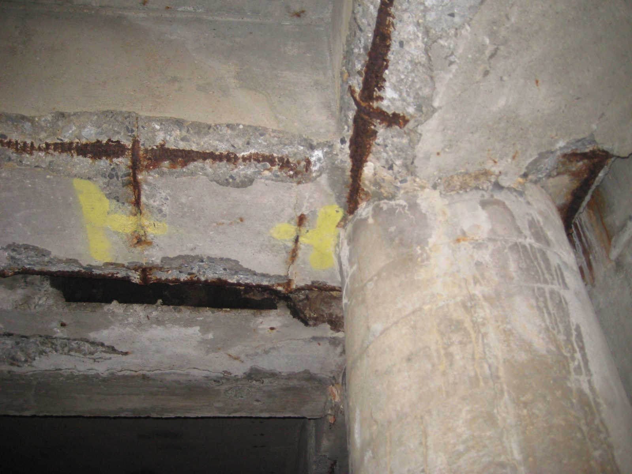

Slide 15
Local Law 126 (cont.)
Biggest problem: who owns the garage in a condominium?
Is the unit owner responsible for the reports?
Is the condominium responsible for the reports?
Position of the DOB?

Slide 16
Local Law 97
Goal is to put NYC’s largest buildings on the path to carbon neutrality by 2050
Applies to buildings over 25,000 square feet
Certain buildings must start meeting limits in 2024 with penalties to start in 2025
Currently caps become more stringent in 2030
Goal is 40% reduction by 2030 and 80% by 2050

Slide 17
Local Law 97
What does this mean for my building?
Projects
Budget
Board responsibilities
Available credits and incentives

Slide 18
Local Law 152
Gas Pipe Inspections
Passed in response to East Village building explosion
Applies to must buildings except 1-2 family homes.
A NYC Licensed Master Plumber must perform the inspection.
Inspections must be done every 4 years.
The Plumber will examine public gas piping to check for leaks.

Slide 19
Flood Disclosure
Section 231-B of the Real Property Law was amended to require that every existing and prospective residential lease provide a notice to the tenant related to the leased premise’s flood history and risk of flooding.
“Flood Risk Right to Know” -- The intent of this new legislation is to increase transparency regarding the risk of flood damage and the availability of insurance to incentivize tenants to obtain adequate protection for their apartments or homes.
This requirement extends to cooperatives and condominiums:
proprietary leases between coops and their shareholders,
subleases between shareholders and their subtenants, and
leases between boards/unit owners in condos and their tenants.
Since Section 231-B only applies to leases, a condominium board does not have to comply with the new flood disclosures unless the condominium board is leasing out one of the condominium apartments.

Slide 20
Flood Disclosure
Notice of the following must be provided:
Past history and current flood risk affecting any of the leased premises arising from natural events that the lessor knows or reasonably should know has occurred to such premises and the nature of any such damage.
Whether the leased premises is located within:
A Federal Emergency Management Agency (FEMA) floodplain,
A special Flood Hazard Area, and/or
AModerate Risk Flood Hazard Area.
Boards should reference FEMA’S Flood Insurance Rate Maps
The availability of flood insurance and limitations of typical insurance policies that do not ordinarily cover flood damage.
Leases must explicitly state: “Flood insurance is available to renters through the Federal Emergency Management Agency’s (FEMA’s) National Flood Insurance Program (NFIP) to cover your personal property and contents in the event of a flood. A standard renter’s insurance policy does not typically cover flood damage. You are encouraged to examine your policy to determine whether you are covered.”

Slide 21
Changes to Cooperative and Condominium Tax Abatement Eligibility Requirements
The Cooperative and Condominium Tax Abatement reduces the property taxes of eligible condominium and co-op owners.
The tax abatement program was introduced to level the playing field between houses and NYC apartments.
In 2022, the City introduced a new law by making every Co-op and Condo looking to leverage NYC’s tax abatement provide a prevailing wage affidavit.
The Prevailing Wage affidavit is proof that a co-op or condo is paying its “building employees” the prevailing wage.
Prevailing Wage: the annual wage and benefit rate set by the city comptroller (not to be mistaken for minimum wage). 32BJ-affiliated employees are receiving prevailing wage
Building employee: Anyone who’s regularly employed to take care of your building eight hours or more each week, including supers, cleaners/porters, door persons, elevator operators etc.
Individual unit owners do not apply for the abatement. Managing agents apply on behalf of their entire development.
Both the development itself and the individual unit owners must meet certain eligibility requirements.

Slide 22
Changes to Cooperative and Condominium Tax Abatement Eligibility Requirements
Eligibility Requirements for Unit Owners
The unit is your primary residence.
You do not own more than three residential units in any one development.
You have filed a real property transfer tax form or deed (condo only)
The unit is not owned by a business, such as an LLC, or held by a sponsor or their successors in interest.
You are not receiving the clergy property tax exemption.
If the unit is owned by a trust, it must be the primary resident of all of the beneficiaries of the trust, trustee, or life estate holder.

Slide 23
Changes to Cooperative and Condominium Tax Abatement Eligibility Requirements
Cooperative and Condominium Eligibility
Buildings with 30 or more residential units and an average assessed unit value of more than $60,000 or buildings with less than 30 residential units and an average assessed unit value of more than $100,000
The development cannot be receiving the J-51 exemption or the 420c, 421a, 421b, or 421g commercial tax benefits. However, you can apply if these benefits are due to expire on June 30 of the tax year in which you are applying.
Properties associated with any of the following are not eligible:
Housing development fund corporations (HDFC)
Limited dividend housing companies
Redevelopment companies
Mitchell-Lama buildings
Division of Alternative Management Programs (DAMP)
Urban Development Action Area Program (UDAAP)

Slide 24
Changes to Cooperative and Condominium Tax Abatement Eligibility Requirements
Buildings are required to pay prevailing wage to remain in the abatement program.
If your building opts-out of paying prevailing wage for the upcoming tax year, shareholders and unit owners will not be eligible to receive an abatement for that year.
The co-op/condo building can decide to opt-in for future years and shareholders and unit owners that meet all necessary criteria will become eligible for the abatement.

Slide 25
Continuing Legal Education Credits
For AT to process your continuing legal education credit, you will be asked to confirm your participation in this webinar by submitting a code word in the Zoom Chat function, which will be provided at the conclusion of the session.
Code Word: Legislation

Slide 26
Andrew P. Brucker
Peter R. Massa
Julie Schechter
212.209.4400
212.209.4455
212.209.4400
abrucker@atllp.com
pmassa@atllp.com
jschechter@atllp.com

